Slide 1
18-349: Introduction to Embedded Real-Time Systems Lecture 5: Serial Buses
Anthony Rowe
Electrical and Computer Engineering
Carnegie Mellon University

Slide 2
Last Lecture
ARM ASM Part 2
Addressing Modes
Batch load
Stack
Memory Mapped Input Output (MMIO)

Slide 3
Lecture Overview
Memory Mapped I/O (review)
Volatile
Serial Communication
Asynchronous protocols
Synchronous protocols
RS-232 data interface
Parity bits
Serial and bit transmissions
SPI
I2C

Slide 4
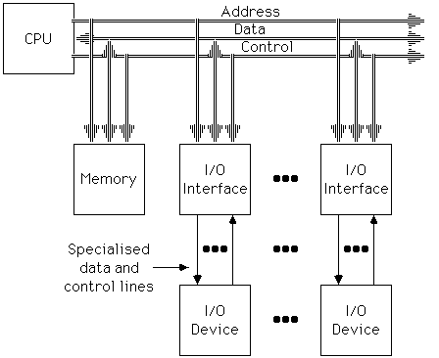
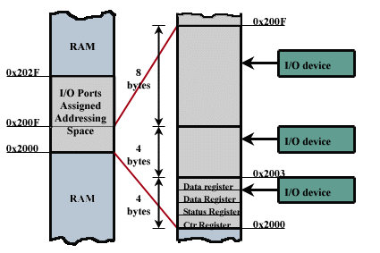
Memory Mapped I/O
Physical Layout
Programmer’s View

Slide 5
Writing Code to Access the Devices
Portability issues – hard-coding the address may pose problems in moving to a new board where the address of the register is different
LDR R0,=0x20200000
MOV R1,#0x0C
STRB R1,[R0]
Should use EQU assembler directive: Equates a symbolic name (e.g., BASE) to a numeric value
BASE EQU 0x20200000
LDR R0, =BASE
Can also access devices using C programs
C pointers can be used to write to a specific memory location
unsigned char *ptr;
ptr = (unsigned char *) 0x20200000;
*ptr = (unsigned char) 0x0C;

Slide 6
I/O Register Basics
I/O Registers are NOT like normal memory
Device events can change their values (e.g., status registers)
Reading a register can change its value (e.g., error condition reset)
For example, can't expect to get same value if read twice
Some are read­only (e.g., receive registers)
Some are write­only (e.g., transmit registers)
Sometimes multiple I/O registers are mapped to same address
Selection of one based on other info (e.g., read vs. write or extra control bits)
Cache must be disabled for memory­mapped addresses – why?
When polling I/O registers, should tell compiler that value can change on its own and therefore should not be stored in a register
volatile int *ptr; (or int volatile *ptr;)

Slide 7
Making the case for volatile
Have you experienced any of the following in your C/C++ embedded code?
Code that works fine-until you turn optimization on
Code that works fine-as long as interrupts are disabled
Flaky hardware drivers
Tasks that work fine in isolation-yet crash when another task is enabled
volatile is a qualifier that is applied to a variable when it is declared
It tells the compiler that the value of the variable may change at any time---most importantly, even with no action being taken by the code that the compiler finds nearby
Notes:
http://www.embedded.com/electronics-blogs/beginner-s-corner/4023801/Introduction-to-the-Volatile-Keyword

Slide 8
Syntax of volatile
volatile variable
volatile int foo;
int volatile foo;
pointer to a volatile variable
volatile int *foo;
int volatile *foo;
volatile pointer to a non-volatile variable (very rare)
int * volatile foo;
volatile pointer to a volatile variable (if you’re crazy)
int volatile * volatile foo;
If you apply volatile to a struct or union, the entire contents of the struct/union are volatile
If you don't want this behavior, you can apply the volatile qualifier to the individual members of the struct/union.

Slide 9
The Use of volatile (1)
A variable should be declared volatile if its value could change unexpectedly
Memory-mapped I/O registers
Global variables that can be modified by an interrupt service routine
Global variables within multi-threaded applications
Example: Let’s poll an 8-bit I/O status register at 0x1234 until it is non-zero
unsigned int *ptr = (unsigned int *) 0x1234;
// wait for I/O register to become non-zero
while (*ptr == 0);
// do something else
What’s wrong with this code? How would you fix it?
Notes:
http://www.eetimes.com/discussion/beginner-s-corner/4023801/Introduction-to-the-Volatile-Keyword
This will almost certainly fail as soon as you turn the optimizer on, since the compiler will generate assembly language that looks something like this:
mov ptr, #0x1234 mov a, @ptr loop bz loop
The rationale of the optimizer is quite simple: having already read the variable's value into the accumulator (on the second line), there is no need to reread it, since the value will always be the same. Thus, in the third line, we end up with an infinite loop. To force the compiler to do what we want, we modify the declaration to:
UINT1 volatile * ptr = (UINT1 volatile *) 0x1234;
The assembly language now looks like this:
mov ptr, #0x1234 loop mov a, @ptr bz loop
The desired behavior is achieved.

Slide 10
The Use of volatile (2)
Example: Write an interrupt-service routine for a serial-port to test each character to see if it represents an EOL character. If it is, we will set a flag to be TRUE.
int eol_rcvd = FALSE;
void main() { ... while (!eol_rcvd) { // Wait } ... }
interrupt void rx_isr(void) { ... if (EOL == rx_char) { eol_rcvd = TRUE; } ... }
How might an optimizer handle
this code? How would you fix it?
Notes:
With optimization turned off, this code might work. However, any half decent optimizer will "break" the code. The problem is that the compiler has no idea that eol_rcvd can be changed within an ISR. As far as the compiler is concerned, the expression !eol_rcvd is always true, and, therefore, you can never exit the while loop. Consequently, all the code after the while loop may simply be removed by the optimizer. If you are lucky, your compiler will warn you about this. If you are unlucky (or you haven't yet learned to take compiler warnings seriously), your code will fail miserably. Naturally, the blame will be placed on a "lousy optimizer."
The solution is to declare the variable eol_rcvd to be volatile. Then all of your problems (well, some of them anyway) will disappear.

Slide 11
Thoughts on volatile
What does the keyword volatile accomplish?
Tells the compiler not to perform certain optimizations
Tells the compiler not to use the cached version of the variable
Indicates that that variable can change asynchronously
Some compilers allow you to declare everything as volatile
Don’t! It’s a substitute for good thinking
Can lead to less efficient code
Don’t blame the optimizer and don’t turn it off
If you are given a piece of code whose behavior is unpredictable
Look for declarations of volatile variables
Look for where you should declare a variable as volatile

Slide 12
Why Serial Communication?
Serial communication is a pin-efficient way of sending and receiving bits of data
Sends and receives data one bit at a time over one wire
While it takes eight times as long to transfer each byte of data this way (as compared to parallel communication), only a few wires are required
Typically one to send, one to receive (for full-duplex), and a common signal ground wire
Simplistic way to visualize serial port
Two 8-bit shift registers connected together
Output of one shift register (transmitter) connected to the input of the other shift register (receiver)
Common clock so that as a bit exits the transmitting shift register, the bit enters the receiving shift register
Data rate depends on clock frequency
Notes:
12

Slide 13
Serial vs. Parallel
MCU 1
MCU 2
Serial
TX
RX
MCU 1
signal
MCU 2
Data[0:7]
Parallel

Slide 14
Simplistic View of Serial Port Operation
Transmitter
Receiver
n
0
1
2
3
4
5
6
7
n
n+1
0
1
2
3
4
5
6
n+1
7
n+2
0
1
2
3
4
5
n+2
6
7
n+3
0
1
2
3
4
n+3
5
6
7
n+4
0
1
2
3
n+4
4
5
6
7
n+5
0
1
2
n+5
3
4
5
6
7
n+6
0
1
n+6
2
3
4
5
6
7
n+7
0
n+7
1
2
3
4
5
6
7
n+8
n+8
0
1
2
3
4
5
6
7
Interrupt raised when
Transmitter (Tx) is empty
a Byte has been transmitted
and next byte ready for loading
Interrupt raised when
Receiver (Rx) is full
a Byte has been received
and is ready for reading
Notes:
14

Slide 15
Simple Serial Port
Receive
Buffer Register
0
1
2
3
4
5
6
7
0
1
2
3
4
5
6
7
Receive
Shift Register
Transmit
Shift Register
0
1
2
3
4
5
6
7
Transmit
Hold Register
0
1
2
3
4
5
6
7
Processor
Peripheral
Notes:
15

Slide 16
Protecting Against Data Loss
How can data be lost?
If the transmitter starts to send the next byte before the receiver has had a chance to process/read the current byte
If the next byte is loaded at the transmitter end before the current byte has been completely transmitted
Most serial ports use FIFO buffers so that data is not lost
Buffering of received bytes at receiver end for later processing
Buffering of loaded bytes at transmitter end for later transmission
Shift registers free to transmit and receive data without worrying about data loss
Why does the size of the FIFO buffers matter?
Notes:
16
The size of the FIFO buffers is important in reducing processor overhead and increasing the serial port’s throughput (Heath).

Slide 17
Serial Port
0
1
2
3
4
5
6
7
0
1
2
3
4
5
6
7
FIFO Buffer
FIFO Buffer
0
1
2
3
4
5
6
7
0
1
2
3
4
5
6
7
Clock
Clock
0
1
2
3
4
5
6
7
0
1
2
3
4
5
6
7
FIFO Buffer
FIFO Buffer
0
1
2
3
4
5
6
7
0
1
2
3
4
5
6
7
Processor
Peripheral
Notes:
17

Slide 18
What is RS-232?
So far, we’ve talked about clocks being synchronized and using the clock as a reference for data transmission
Fine for short distances (e.g., within chips on the same board)
When data is transmitted over longer distances (off-chip), voltage levels can be affected by cable capacitance
A logic “1” might appear as an indeterminate voltage at the receiver
Wrong data might be accepted when clock edges become skewed
Enter RS232: Recommended Standard number 232
Serial ports for longer distances, typically, between PC and peripheral
Data transmitted asynchronously, i.e., no reference clock
Data provides its own reference clock
Notes:
18

Slide 19
Types of Serial Communications
Synchronous communication
Data transmitted as a steady stream at regular intervals
All transmitted bits are synchronized to a common clock signal
The two devices initially synchronize themselves to each other, and then continually send characters to stay synchronized
Faster data transfer rates than asynchronous methods, because it does not require additional bits to mark the beginning and end of each data byte
Asynchronous communication
Data transmitted intermittently at irregular intervals
Each device uses its own internal clock resulting in bytes that are transferred at arbitrary times
Instead of using time as a way to synchronize the bits, the data format is used
Data transmission is synchronized using the start bit of the word, while one or more stop bits indicate the end of the word
Asynchronous communications slightly slower than synchronous
Notes:
19

Slide 20
Sync vs. Async
Synchronous communications
Requires common clock (SPI)
Whoever controls the clock controls communication speed
Asynchronous communications
Has no clock (UART)
Speed must be agreed upon beforehand (the baud-rate configuration accomplishes that)

Slide 21
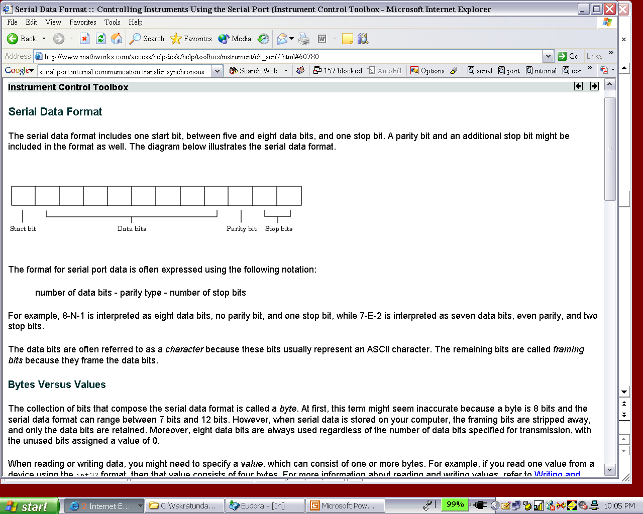
RS232 – Bits and Serial Bytes
Serial ports on IBM-style PCs support asynchronous communication only
A “serial byte” usually consists of
Characters: 5-8 data bits
Framing bits: 1 start bit, 1 parity bit (optional), 1-2 stop bits
When serial data is stored on your computer, framing bits are removed, and this looks like a real 8-bit byte
Specified as number of data bits - parity type - number of stop bits
8-N-1 a eight data bits, no parity bit, and one stop bit
7-E-2 a seven data bits, even parity, and two stop bits
MSB
LSB
0 1 2 3 4 5 6 7
7
6
5
4
3
2
1
0
Notes:
21

Slide 22
Parity Bits
Simple error checking for the transmitted data
Even parity
The data bits produce an even number of 1s
Odd parity
The data bits produce an odd number of 1s
Parity checking process
The transmitting device sets the parity bit to 0 or to 1 depending on the data bit values and the type of parity checking selected.
The receiving device checks if the parity bit is consistent with the transmitted data; depending on the result, error/success is returned
Disadvantage
Parity checking can detect only an odd number of bit-flip errors
Multiple-bit errors can appear as valid data
Notes:
22

Slide 23
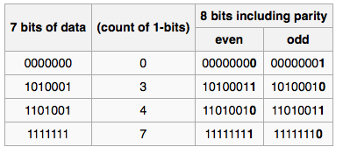
Parity Example
Value Typically Including Parity Bit

Slide 24
Data Modulation
When sending data over serial lines, logic signals are converted into a form the physical media (wires) can support
RS232C uses bipolar pulses
Any signal greater than +3 volts is considered a space (0)
Any signal less than ­3 volts is considered a mark (1)
Conventions
Idle line is assumed to be in high (1) state
Each character begins with a zero (0) bit, followed by 5-8 data bits and then 1, 1­1/2, or 2 closing stop bits
Bits are usually encoded using ASCII (American Standard Code for Information Interchange)
Notes:
24

Slide 25
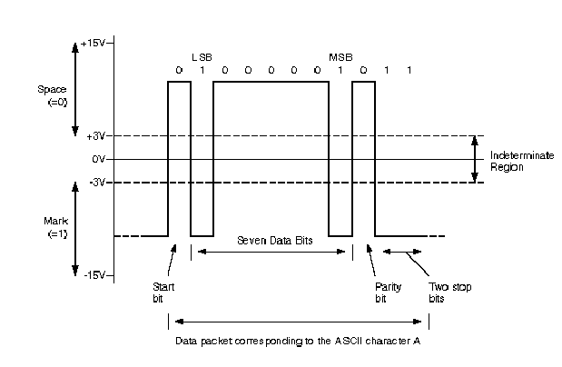
RS-232 Signal Levels
Source: Dallas Semiconductors
Application note 83
Notes:
25
With 1 or 2 stop bits the line output is held at the mark level for 1 or 2 times a bit duration.
With 1.5 stop bits imply that the line output is held at the mark level for 1.5 times a single bit duration, useful in detecting certain synchronization errors because if there is an immediate character to be TX/RX next it’s start bit would cause a change in the voltage level in the middle of a bit signifying the definite presence of a stop bit
Width of a bit is determined by baud rate. 9600 baud, 1 bit=1/9600=0.104 mS. So, start bit would be held for 0.104ms

Slide 26
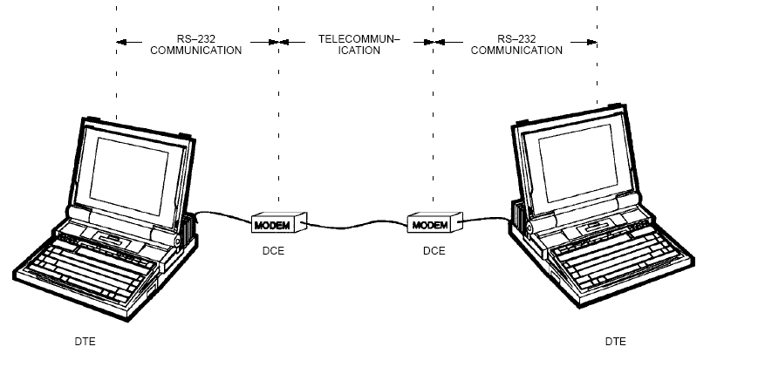
Terminology
DTE: Data terminal equipment, e.g., PC
DCE: Data communication equipment, e.g., modem, remote device
Baud Rate
Maximum number of times per second that a line changes state
Not always the same as bits per second
Source: Dallas Semiconductors
Application note 83
Notes:
26

Slide 27
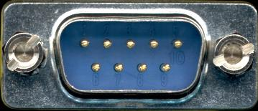
Serial Port Connector
9-pin (DB-9) or 25-pin (DB-25) connector
Inside a 9-pin connector
Carrier Detect - Determines if the DCE is connected to a working phone line
Receive Data - Computer receives information sent from the DCE
Transmit Data - Computer sends information to the DCE
Data Terminal Ready - Computer tells the DCE that it is ready to talk
Signal Ground - Pin is grounded
Data Set Ready - DCE tells the computer that it is ready to talk
Request To Send - Computer asks the DCE if it can send information
Clear To Send - DCE tells the computer that it can send information
Ring Indicator – Asserted when a connected modem has detected an incoming call
What’s a null modem cable?
Notes:
27
The RS-232 standard is asymmetrical as to the definitions of the two ends of the communications link so it assumes that one end is a DTE and the other is a DCE e.g. a modem. With a null modem connection the transmit and receive lines are crosslinked. Depending on the purpose, sometimes also one or more handshake lines are crosslinked. Several wiring layouts are in use because the null modem connection is not covered by a standard.

Slide 28
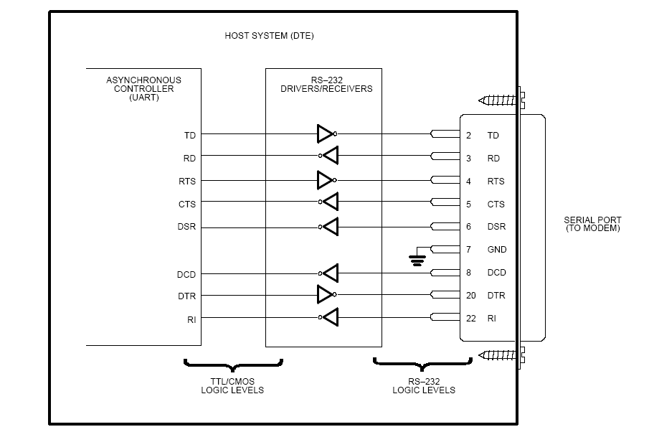
RS-232 Pin Connections
Source: Dallas Semiconductors
Application note 83
Notes:
28

Slide 29
Handshaking
Some RS232 connections using handshaking lines between DCE and DTE
RTS (ReadyToSend) • Sent by the DTE to signal the DCE it is Ready To Send
CTS (ClearToSend) • Sent by the DCE to signal the DTE that it is Ready to Receive
DTR (DataTerminalReady) • Sent to DTE to inform the DCE that it is ready to connect
DSR (DataSetRead) • Sent to DCE to inform the DTE that it is ready to connect
Handshaking lines can make it difficult to set up the serial communications, but seamless after set-up.
Also, software handshaking (XON/XOFF)

Slide 30
Serial Data Communication Modes
Transmit or Receive
Transmit
Transmit
Receive
Simplex Mode
Transmission is possible only in one direction.
Half-duplex Mode
Data is transmitted in one direction at a time but the direction can be changed.
Full-duplex Mode
Data may be transmitted simultaneously in both directions.
Notes:
30

Slide 31
Interfacing Serial Data to Microprocessor
Processor has parallel buses for data ­­ need to convert serial data to parallel (and vice versa)
Standard way is with UART
UART ­ Universal asynchronous receiver and transmitter
Chip Reg
Select
R/W
Control
Tx Clock
Tx Data Reg
Tx Shift Reg
Tx Data
IRQ
Status Reg
CTS
D₀-D₇
Data
Bus
Buffers
Control Reg
RTS
Rx Data Reg
Rx Shift Reg
Rx Data
Rx Clock
Notes:
31

Slide 32
Flow Control
Necessary to prevent terminal from sending more data than the peripheral can consume (and vice-versa)
Higher data rates can result in missing characters (data-overrun errors)
Hardware handshaking
Hardware in UART detects a potential overrun and asserts a handshake line to prevent the other side from transmitting
When receiving side can take more data, it releases the handshake line
Software flow-control
Special characters XON and XOFF
XOFF stops a data transfer (control-S or ASCII code 13)
XON restarts the data transfer (control-Q or ASCII code 11)
Assumption is made that the flow-control becomes effective before data loss happens
Notes:
32

Slide 33
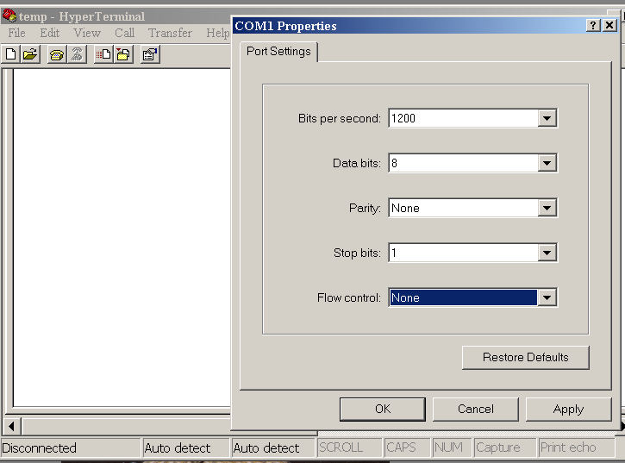
HyperTerminal / Minicom
A (hyper) terminal program is an application that will enable a PC to communicate directly with a serial port
Can be used to display data received at the PC’s serial port
Can be used to configure the serial port
Baud rate
Number of data bits
Number of parity bits
Number of stop bits
Flow control
Notes:
33

Slide 34
UART and MMIO (Example)
#define UART2_BASE 0x20100000
#define UART2_LS_DIV (UART2_BASE + 0x00)
#define UART2_MS_DIV (UART2_BASE + 0x01)
#define UART2_TX_REG (UART2_BASE + 0x00)
#define UART2_RX_REG (UART2_BASE + 0x00)
#define UART2_INT_ID (UART2_BASE + 0x01)
#define UART2_INT_EN_REG (UART2_BASE + 0x01)
#define UART2_FIFO_CNTRL (UART2_BASE + 0x02)
#define UART2_LINE_CNTRL (UART2_BASE + 0x03)
#define UART2_MODM_CNTRL (UART2_BASE + 0x04)
#define UART2_LINE_STAT (UART2_BASE + 0x05)
#define UART2_MODM_STAT (UART2_BASE + 0x06)
#define UART2_SCRATCH (UART2_BASE + SCRATCH_OFFSET)
Notes:
34

Slide 35
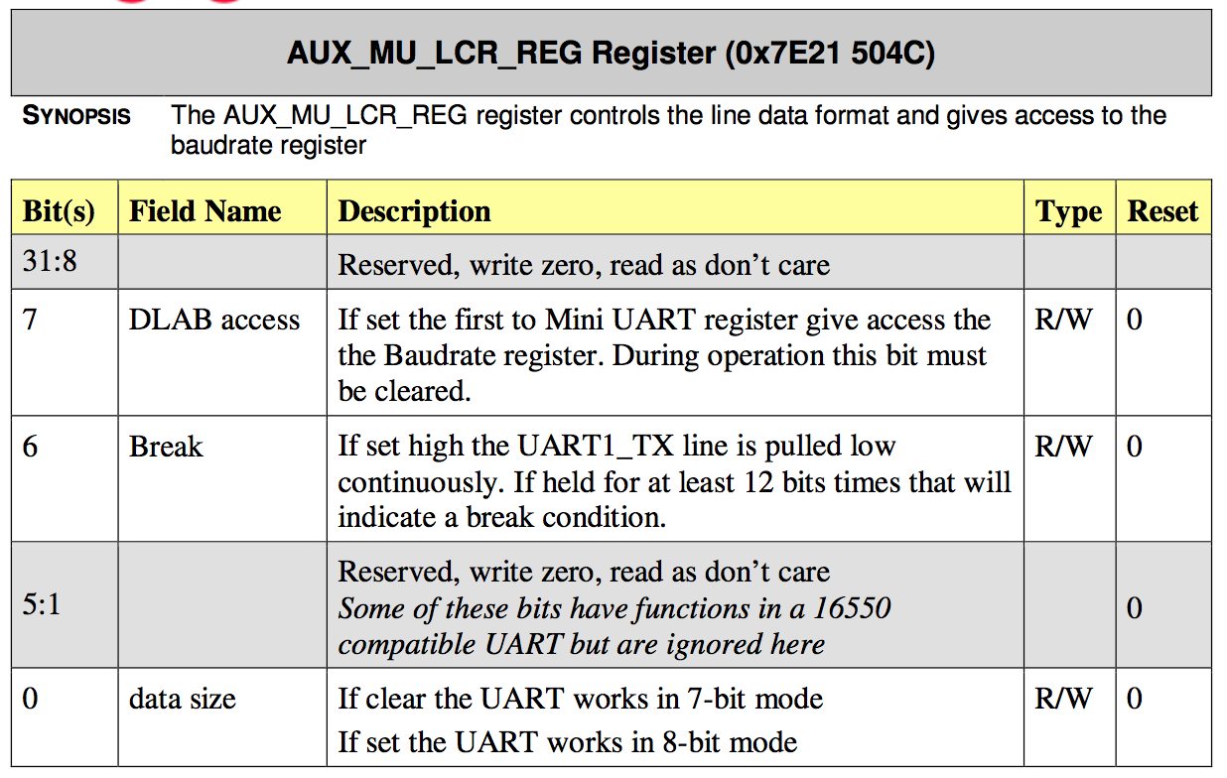
Example – RPI LCR Register

Slide 36
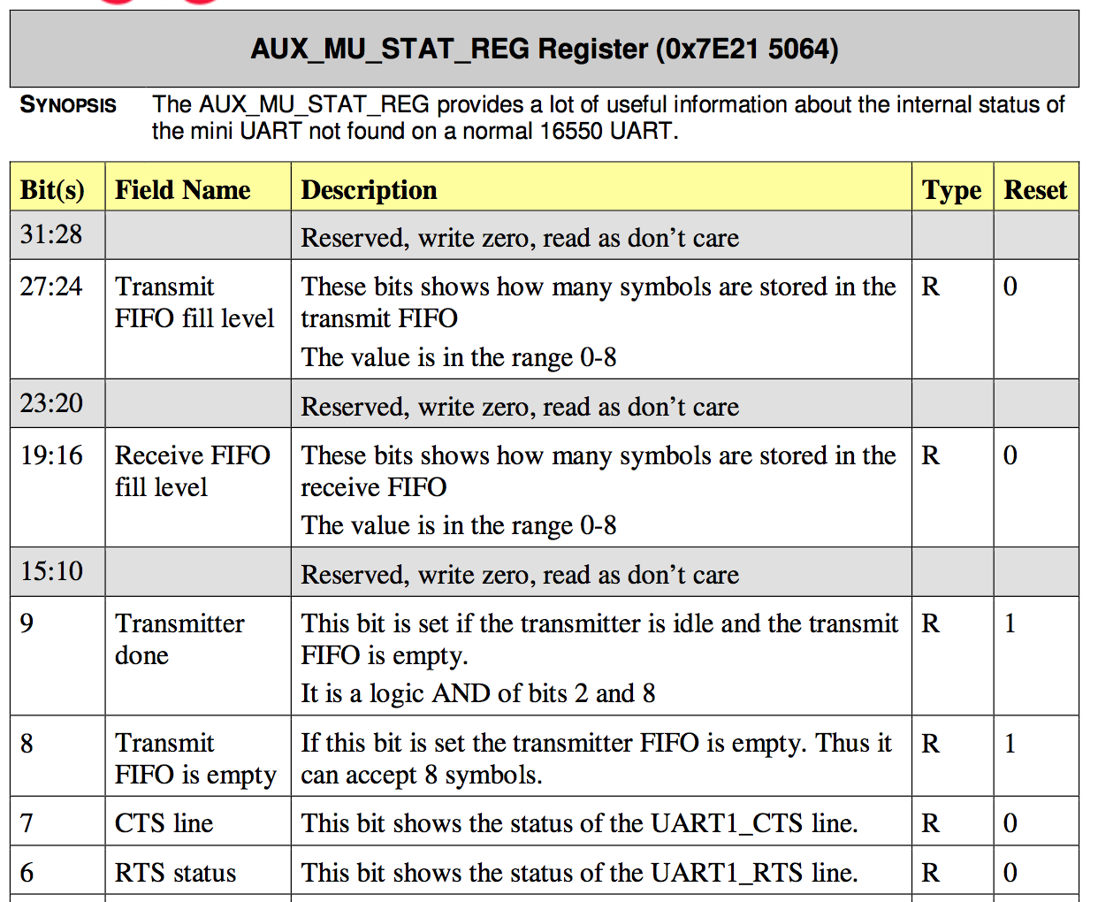
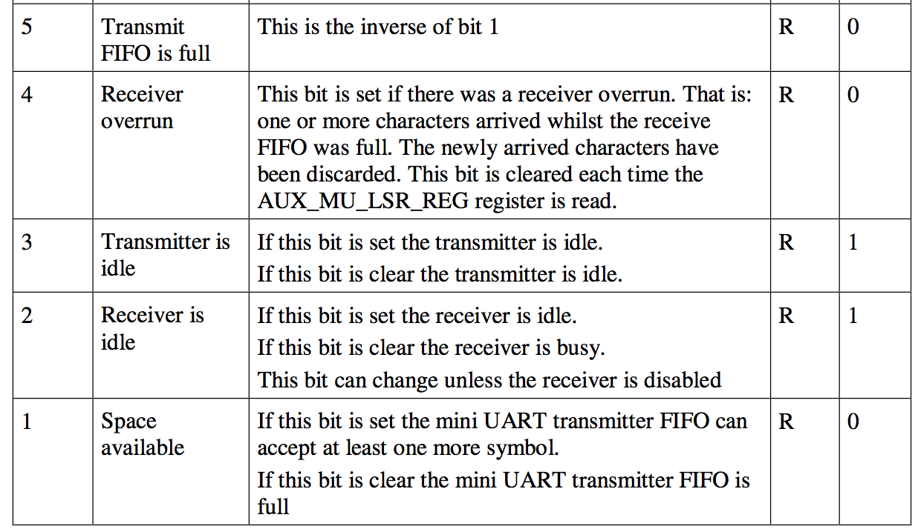
Example – RPI status register
Notes:
36

Slide 37

Serial vs. Parallel
Serial ports
Universal Asynchronous Receiver/Transmitter (UART): controller
Takes the computer bus’ parallel data and serializes it
Transfer rate of 115 Kbps
Example usage: Modems
Parallel ports
Sends/receives the 8 bits in parallel over 8 different wires
50-100 KBps (standard), upto 2 MBps (enhanced)
Example usage: Printers, Zip drives
PARALLEL
SERIAL
Notes:
37

Slide 38
Other Serial Buses
I2C
Two wire chip interconnect, multi-drop
RS-232
Point-to-point +/-12V
I2S
Audio format similar to SPI
RS-485
Multi-drop RS-232
SPI
Four wire only chip interconnect, multi-drop
Many more…

Slide 39
Serial Peripheral Interconnect (SPI)
Another kind of serial protocol in embedded systems (proposed by Motorola)
Four-wire protocol
SCLK — Serial Clock
MOSI/SIMO — Master Output, Slave Input
MISO/SOMI — Master Input, Slave Output
SS — Slave Select
Single master device and with one or more slave devices
Higher throughput than I2C and can do “stream transfers”
No arbitration required
But
Requires more pins
Has no hardware flow control
No slave acknowledgment (master could be talking to thin air and not even know it)
Notes:
Better suited for “data streams”, i.e. ADC converters
Full duplex capability, i.e. communication between a codec and digital signal processor

Slide 40
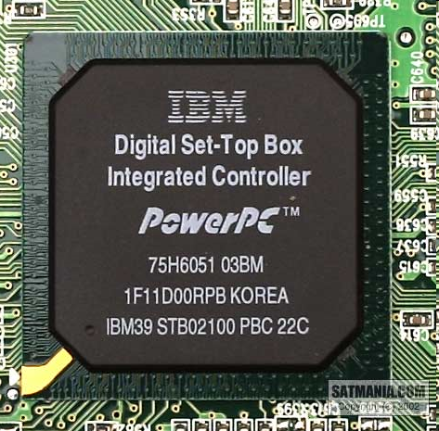
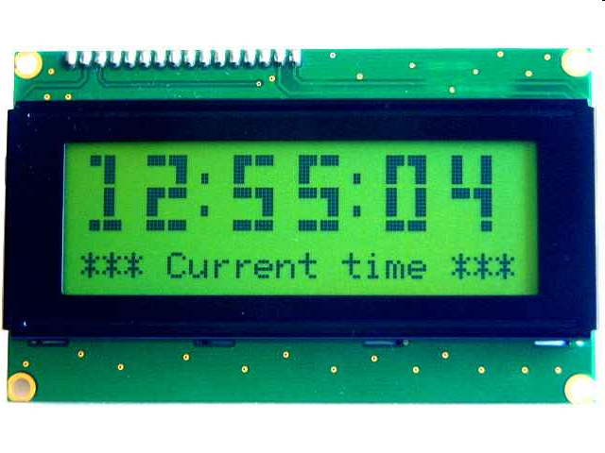
What is SPI?
Serial Bus protocol
Fast, Easy to use, Simple
Everyone supports it

Slide 41
SPI Basics
A communication protocol using 4 wires
Also known as a 4 wire bus
Used to communicate across small distances
Multiple Slaves, Single Master
Synchronized

Slide 42
SPI Capabilities
Always Full Duplex
Communicating in two directions at the same time
Transmission need not be meaningful
Multiple Mbps transmission speed
Transfers data in 4 to 16 bit characters
Multiple slaves
Daisy-chaining possible

Slide 43
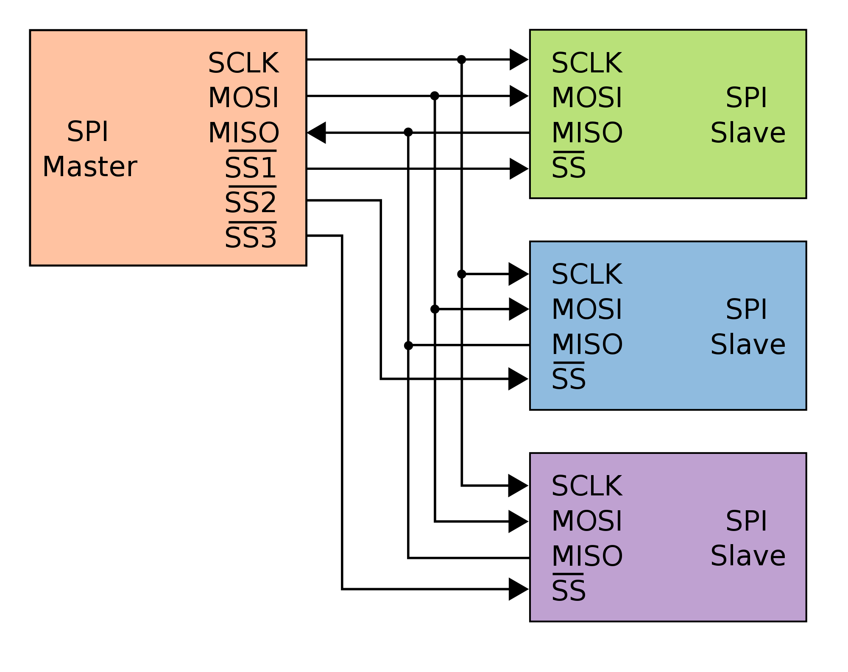
SPI Protocol
Wires:
Master Out Slave In (MOSI)‏
Master In Slave Out (MISO)‏
System Clock (SCLK)‏
Slave Select 1…N
Master Set Slave Select low
Master Generates Clock
Shift registers shift in and out data

Slide 44
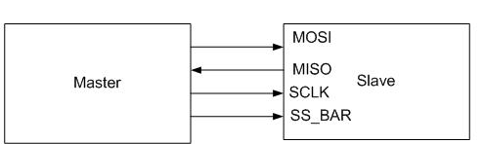
SPI Wires in Detail
MOSI – Carries data out of Master to Slave
MISO – Carries data from Slave to Master
Both signals happen for every transmission
SS_BAR – Unique line to select a slave
SCLK – Master produced clock to synchronize data transfer

Slide 45
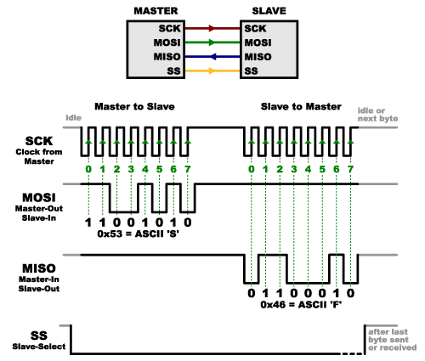
SPI Communication

Slide 46
SPI Pros and Cons
Pros:
Fast and easy
Fast for point-to-point connections
Easily allows streaming/Constant data inflow
No addressing/Simple to implement
Everyone supports it
Cons:
SS makes multiple slaves very complicated
No acknowledgement ability
No inherent arbitration
No flow control

Slide 47
I2C Background
I2C is also written as I²C (pronounced “eye-squared-see” or “eye-two-see”)
Stands for Inter-Integrated Circuit (IIC)
Two-wire party-line bus for “inside the box” communication
Intended for short-range communication between ICs on a circuit board or across boards in an embedded system
I2C devices commonly used in industrial applications
EEPROMs, thermal sensors, real-time clocks, RF tuners, video decoders/encoders
Philips Semiconductors is the primary champion of I2C
Specification publicly available at http://www.nxp.com/acrobat_download/literature/9398/39340011.pdf
Originally developed for communication between devices inside a TV set in the mid-1980s

Slide 48
I2C Purpose
Designed by Philips ~20 years ago
Original purpose was to allow easy communication between components which resided on the same circuit board
Combines hardware and software protocols to provide a bus interface that can connect many peripheral devices
I2C is now not only used on single boards, but also to connect components which are linked via cable
All I2C-compatible devices have an on-chip interface that allows them to communicate directly with each other via the I2C-bus
Supports easy, ready-to-use interfacing of various boards and digital circuits (even if they are independently designed)
Allows for “plug-and-play” and evolution of ICs into a larger system

Slide 49
I2C Characteristics
Only two bus lines are required
Each device connected to the bus is software-addressable by a unique address and
Simple master/slave relationships
True multi-master bus including collision detection and arbitration to prevent data corruption if two or more masters simultaneously initiate data transfer
Serial, 8-bit oriented, bidirectional data transfers
Up to 100 kbit/s in the standard mode
Up to 400 kbit/s in the fast mode
High-speed (3.4 Mbps), I2C version2.0
On-chip filtering rejects spikes on the bus data line to preserve data integrity

Slide 50
I2C Design Criteria
First of all, this is a serial bus
Targeting 8-bit microcontroller applications
Serial vs. parallel – anyone remember pros and cons?
Criteria for design of I2C
Need to avoid confusion between connected devices
Fast devices must be able to communicate with slow ones
Protocol must not be dependent on the devices that it connects
Need to have a mechanism to decide who controls the bus and when
If different devices with different clock speeds are connected, the bus clock speed must be defined
Notes:
Although serial buses don’t have the throughput capability of parallel buses, they do require less wiring and fewer IC
connecting pins.

Slide 51
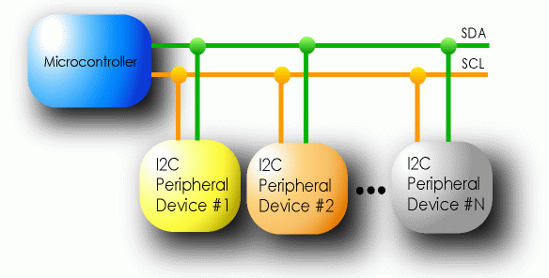
I2C Details
Two lines: Serial data line (SDA) & serial clock line (SCL)
Each I2C device recognized by a unique address
Each I2C device can be either a transmitter or receiver
I2C devices can be masters or slaves for a data transfer
Master (usually a microcontroller): Initiates a data transfer on the bus, generates the clock signals to permit that transfer, and terminates the transfer
Slave: Any device addressed by the master at that time
Roles/relationships are not permanent

Slide 52
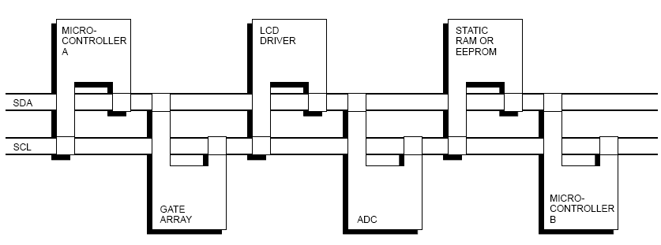
I2C-Connected System
Example I2C-connected system with two microcontrollers
(Source: I2C Specification, Philips)

Slide 53
Master-Slave Relationships
Masters can operate as master-transmitters or master-receivers
Suppose microcontroller A wants to send information to microcontroller B
A (master) addresses B (slave)
A (master-transmitter), sends data to B (slave-receiver)
A terminates the transfer.
If microcontroller A wants to receive information from microcontroller B
A (master) addresses microcontroller B (slave)
A (master-receiver) receives data from B (slave-transmitter)
A terminates the transfer
In both cases, the master (microcontroller A) generates the timing and terminates the transfer

Slide 54
Multi-Master Capability
Clearly, more than one microcontroller can be connected to the bus
What if both microcontrollers want to control the bus at the same time?
Multi-master I2C capability supports this without corrupting the message
Wired-AND connection of all I2C interfaces to the bus for arbitration
If two or more masters try to put information onto the bus, the first to produce a ‘one’ when the other produces a ‘zero’ loses
Clock signals during arbitration are a synchronized combination of the clocks generated by the masters using the wired-AND connection to the SCL line
Generation of clock signals on the bus
Each master generates its own clock signals when transferring data on the bus
A master’s bus clock signals can be altered when stretched by a slow-slave device holding down the clock line, or by another master during arbitration
Notes:
I2C devices can slow down communication by stretching SCL: During an SCL low phase, any I2C device on the bus may additionally hold down SCL to prevent it to rise high again, enabling them to slow down the SCL clock rate or to stop I2C communication for a while. This is also referred to as clock synchronization.
Note: The I2C specification does not specify any timeout conditions for clock stretching, i.e. any device can hold down SCL as long as it likes.

Slide 55
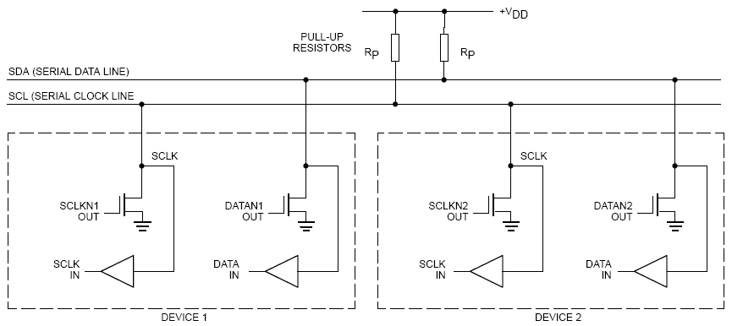
Connecting I2C Devices to the Bus
Notes:
Both SDA and SCL are bidirectional lines, connected to a positive supply voltage via a pull-up resistor (see Figure 4). When the bus is free, both lines are HIGH. The output stages of devices connected to the bus must have an open-drain or open-collector in order to perform the wired-AND function. The number of interfaces connected to
the bus is solely dependent on the bus capacitance limit of 400pF.
SDA and SCL are open-drain (also known as open-collector in the TTL world), that is I2C master and slave devices can only drive these lines low or leave them open. The termination resistor Rp pulls the line up to Vcc if no I2C device is pulling it down.

Slide 56

Addressing
First byte of transfer contains the slave address and the data direction
Address is 7 bits long, followed by the direction bit
Like all data bytes, address is transferred with the most significant bit first
7-bit address space allows for 128 unique I2C device addresses
16 addresses are reserved for special purposes
Leaves only 112 addresses with this 7-bit address scheme
New 10-bit address scheme has been introduced
“General call” broadcast – to address every device on the bus
What is the maximum number of devices in I2C limited by?
Notes:
The maximum number of nodes is obviously limited by the address space, and also by the total bus capacitance of 400 pF.

Slide 57

Clock Stretching
Form of flow control
An addressed slave device may hold the clock line low after receiving (or sending) a bit, indicating that it is not yet ready to process more data
Master that is communicating with the slave will attempt to raise the clock to transfer the next bit, but
If the slave is clock stretching, the clock line will still be low
Mechanism allows receivers that cannot keep up with a transmitter to control the flow of incoming data

